Slide 1
TASK
Name the following shapes below:
1)
2)
3)
4)
5)
RHOMBUS
PARALLELOGRAM
ISOSCELES
TRIANGLE
PENTAGON
ISOSCELES
TRAPEZIUM
6)
7)
8)
9)
10)
HEXAGON
HEPTAGON
OCTAGON
DECAGON
DODECAGON
EXTENSION
Sketch and name as many solids (3D shapes) as you can.
Notes:
1

Slide 2
What on Earth is Tessellation?
A tessellation is created when a shape is repeated over and over again covering an area without any gaps or overlaps.

Slide 3
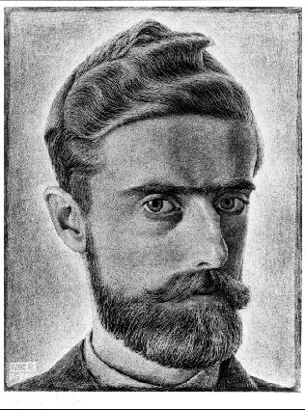
So who is this Escher guy?
Maurits Cornelis Escher, usually referred to as M. C. Escher, was a Dutch graphic artist. He is known for his often mathematically inspired tessellations.
Let’s take a look at some of his work…

Slide 4
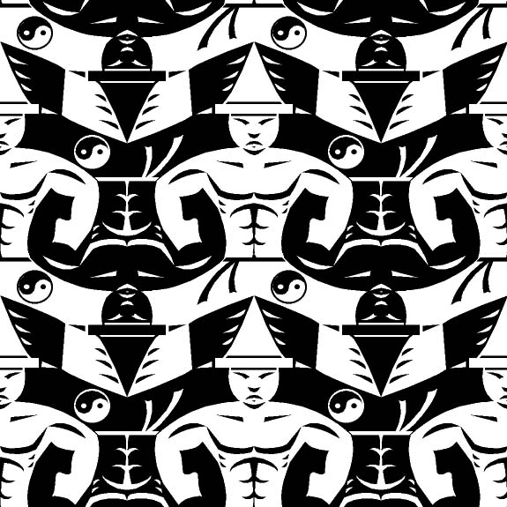

Slide 5
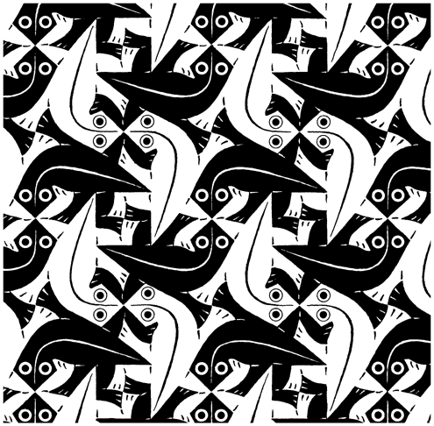

Slide 6
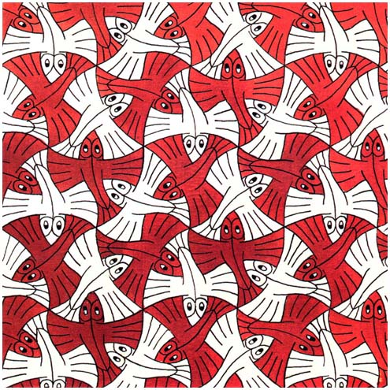

Slide 7
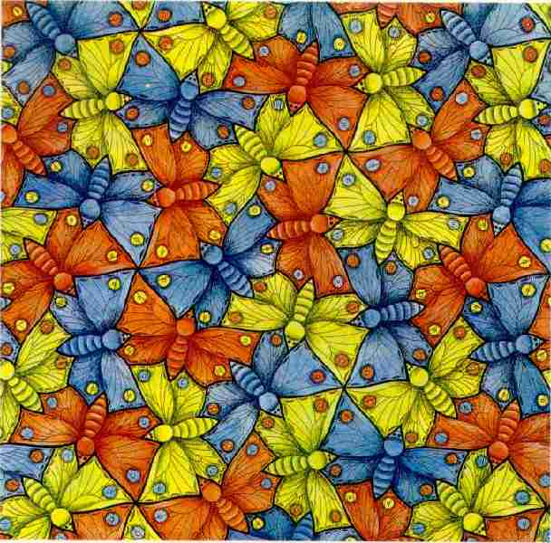

Slide 8
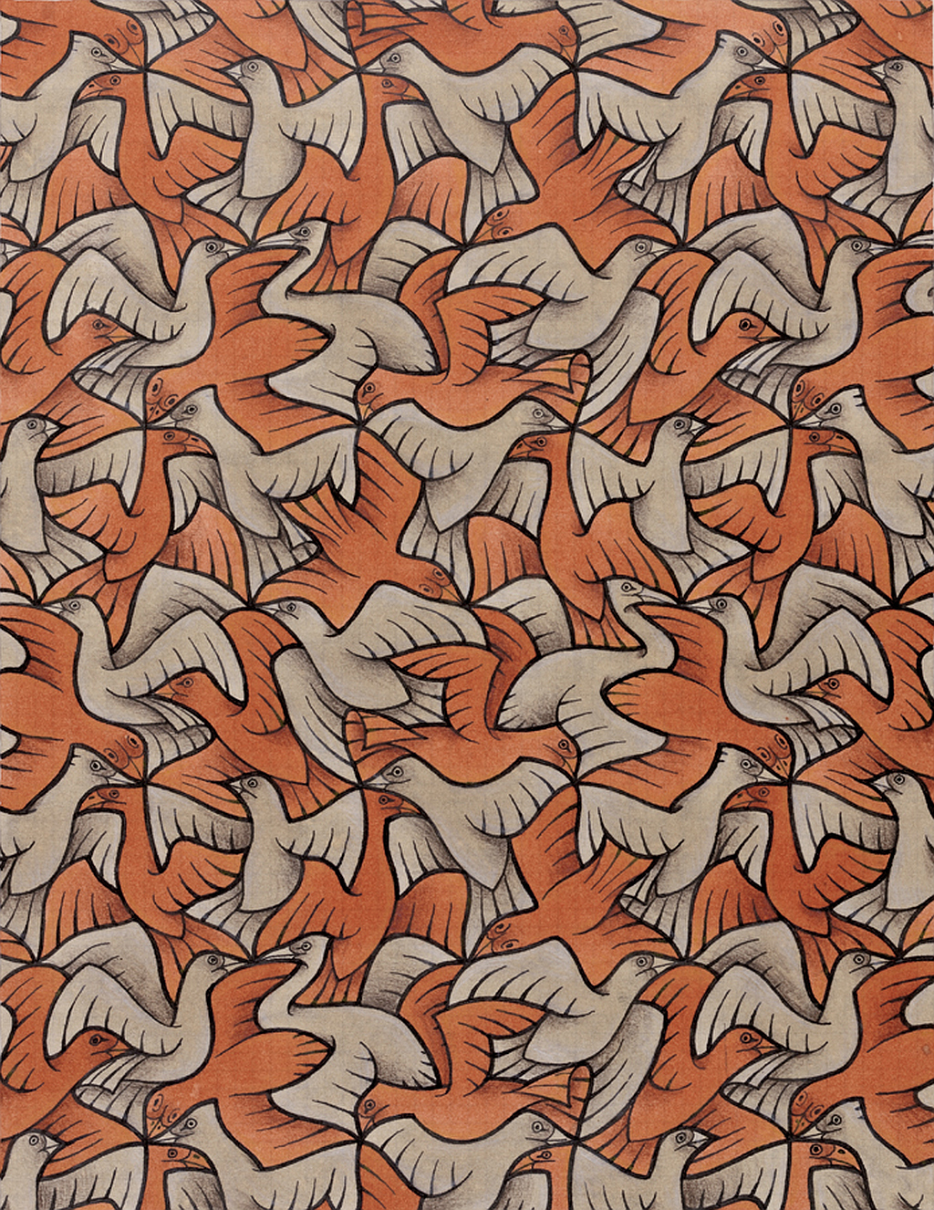

Slide 9
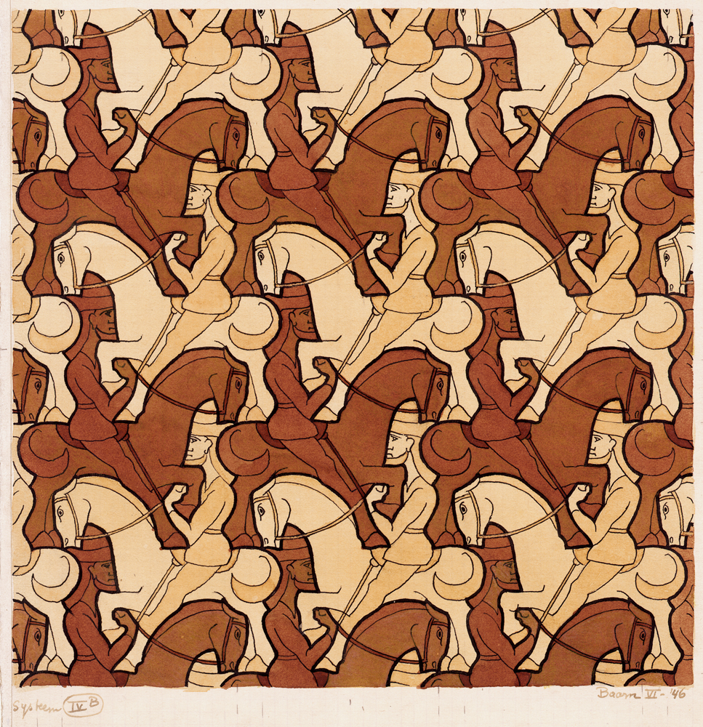

Slide 10
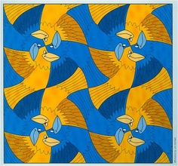

Slide 11
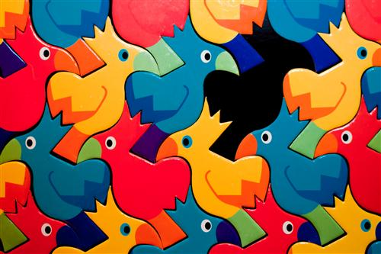

Slide 12
Where do we see tessellation in everyday life?

Slide 13
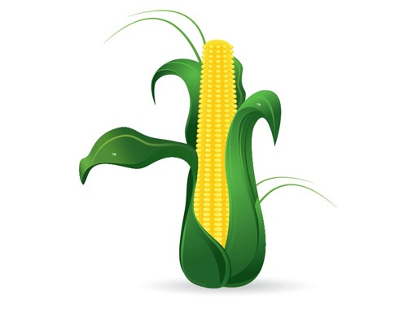
Corn on the cob

Slide 14
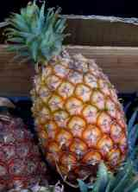
Pineapple

Slide 15
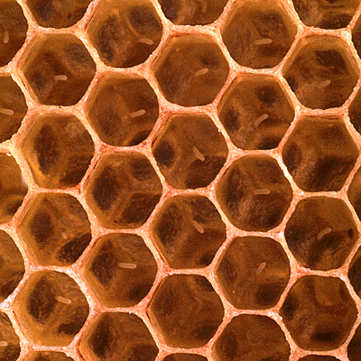
Honeycomb

Slide 16
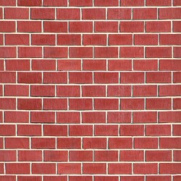
Brick Laying

Slide 17
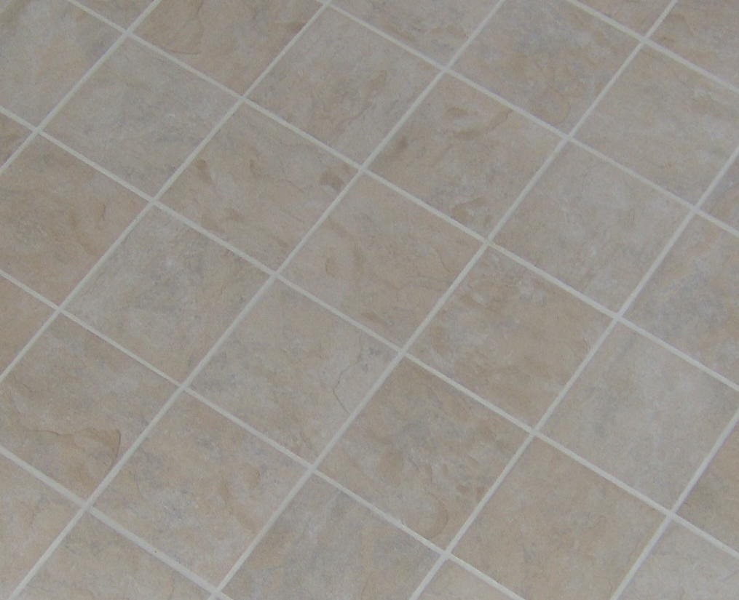
Floor Tiles

Slide 18
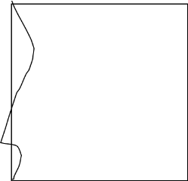
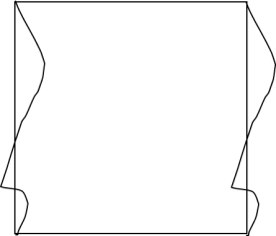
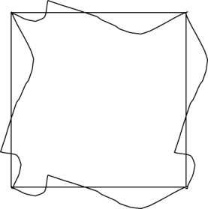

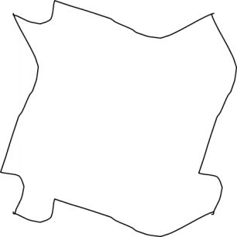
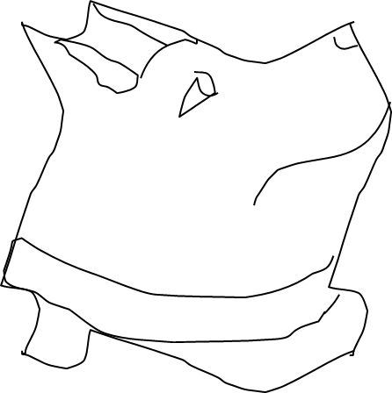
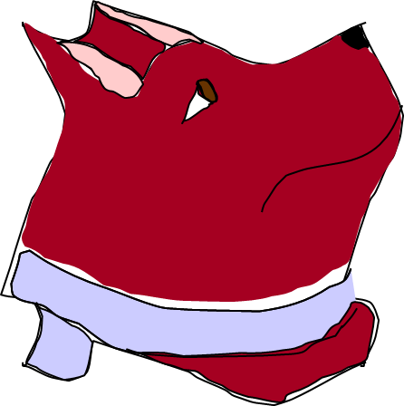
TESSELLATIONS
HOW TO MAKE AN ESCHERESQUE TESSELLATION
STEP 1
STEP 2
STEP 3
STEP 4
Begin with a simple shape
Change the shape of one side
Copy this line on the opposite side
Rotate the line and repeat it on the remaining edges
STEP 5
STEP 6
STEP 7
Erase the original shape (square)
Add lines inside the shape to make a picture
Add colour to enhance your picture
Notes:
18

Slide 19
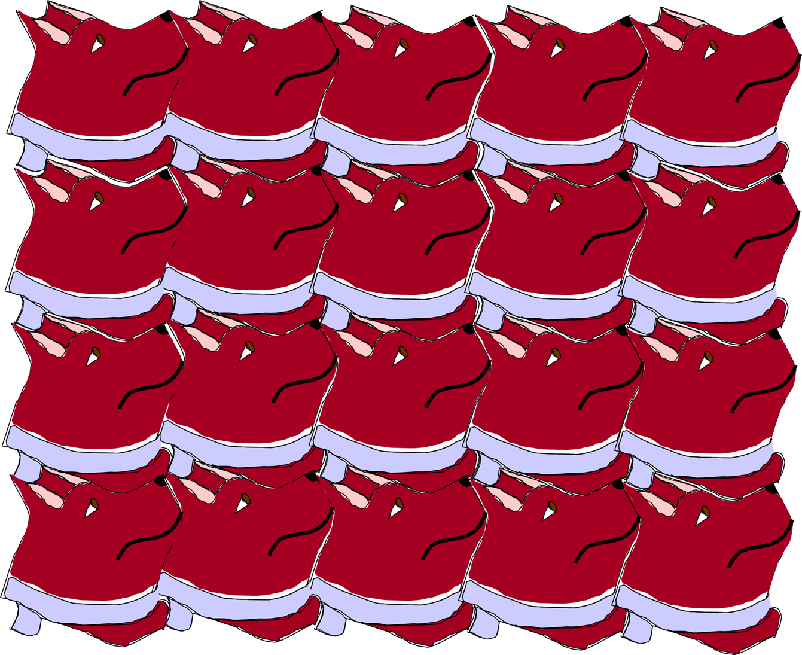
TESSELLATIONS
HOW TO MAKE AN ESCHERESQUE TESSELLATION
Notes:
19

Slide 20
TESSELLATIONS
EXAMPLES
1)
TASK
Show that the kite tessellates by drawing on at least six more kites on the grid.
Notes:
20

Slide 21
TESSELLATIONS
EXAMPLES
2)
TASK
Show that the hexagon tessellates by drawing on at least six more hexagons on the grid.
Notes:
21

Slide 22
TESSELLATIONS
EXAMPLES
3)
TASK
Show that the trapezium tessellates by drawing on at least eight more trapezia on the grid.
Notes:
22

Slide 23
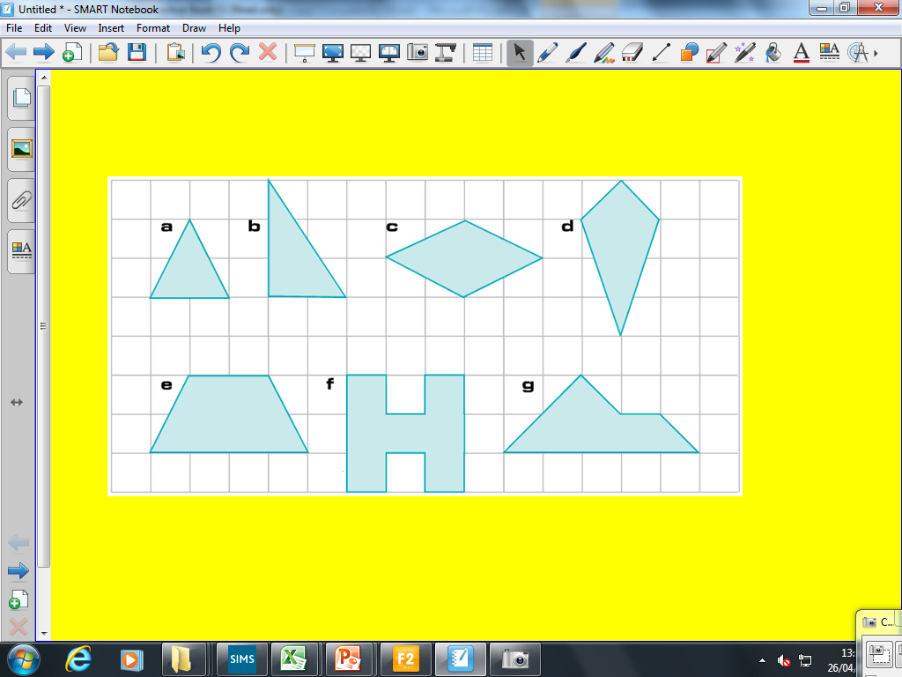
TESSELLATIONS
TASK
1) On squared paper show how each of these shapes tessellate:
EXTENSION (GRADE D)
1) Explain why equilateral triangles, squares and regular hexagons tessellate.
2) Develop your own Escheresque tessellations.
Notes:
23

Slide 24
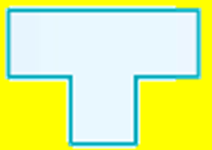
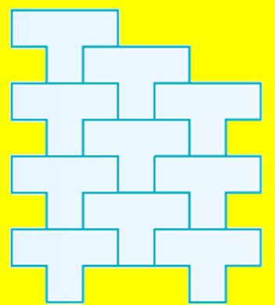
TESSELLATIONS
Draw the tessellation of the shape below:
Notes:
24

